Slide 1
Dissertation Guidelines
Chapter 2 Literature Review
Andre Samuel

Slide 2
Purpose of the Review
This chapter situates the study in the context of previous research and scholarly material pertaining to the topic
Presents a critical synthesis of empirical literature according to relevant themes
Review of sources that are mostly recent empirical studies from scholarly journals and publications

Slide 3
What to Include in the Review?
What you review should be clearly related to:
The problem statement
Purpose of the research
Research Question/s
Research Objectives
Ask yourself:
What do you need to know to answer the RQ and achieve the objectives?

Slide 4
Use RQ and Objectives to identify Themes/Keywords
Examples

Slide 5
Title- A Critical investigation of the financial performance of a Credit Union using Ratio Analysis
RQ: What are the key financial strengths and weaknesses of a credit union using Ratio Analysis?
Aim: To identify the overall financial health of the credit union with a focus on financial weaknesses and strengths
Objectives:
To critically evaluate the capacity to make a profit and grow their business i.e. profitability
To analyze the ability to meet short-term financial obligation, i.e. liquidity
To determine the extent to which the credit union is using their business assets i.e. efficiency

Slide 6
A Critical Analysis of the Determinants of Tax Morale
Research Question
Objectives
What are the determinants of tax morale?
1. To evaluate trust in the government as a determinant of tax morale.
2. To evaluate religiosity as a determinant of tax morale.
3. To evaluate demographic and socio-economic factors as determinants of tax morale.

Slide 7
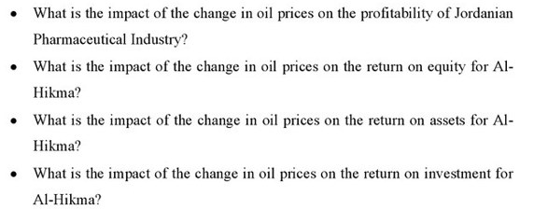
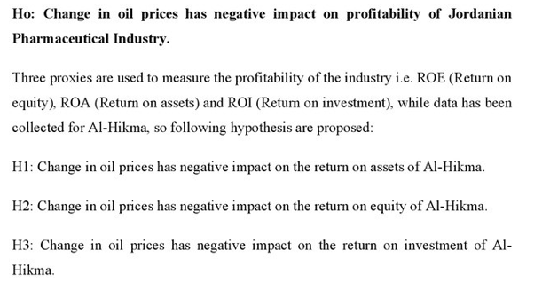
Title: The Impact of Change in Oil prices on the Profitability of Jordanian Pharma Industry
Research Questions
Hypotheses

Slide 8
Importance of identifying the Keywords
By identifying the keywords you should start to visualize a structure for the review
Each of the Keywords will become a THEME in the review
Example 1:
RQ: What are the key financial strengths and weaknesses of a credit union using Ratio Analysis
Tells me I should have a theme call Ratio Analysis i.e. convert to a Heading
2.1 Ratio Analysis
Objective: 1. To critically evaluate the capacity to make a profit and grow their business i.e. profitability
Tells me I should have a theme for Profitability Ratios i.e. convert to a Sub-Heading
2.1.1 Profitability Ratios

Slide 9
Example 1- Working out the Structure
RQ: What are the key financial strengths and weaknesses of a credit union using Ratio Analysis
Tells me I should have a theme call Ratio Analysis i.e. convert to a Heading
Objective: 1. To critically evaluate the capacity to make a profit and grow their business i.e. profitability
Tells me I should have a theme for Profitability Ratios
2.0 Introduction
2.1 Ratio Analysis
2.2 Profitability Ratios
etc

Slide 10
Example 2:
RQ: What are the determinants of tax morale?
Objectives:
1. To evaluate trust in the government as a determinant of tax morale.
2. To evaluate religiosity as a determinant of tax morale.
3. To evaluate demographic and socio-economic factors as determinants of tax morale.
2.0 Introduction
2.1 Determinants of Tax Morale
2.1.1 Trust
2.1.2 Religion
2.1.3 Demographic and Social

Slide 12
Steps in Conducting a Lit Review
With these keywords begin searching books, journals, online databases etc
Initially try to locate as many as you can, reports of research articles or books related to your topic
Skim this initial group of articles or chapters and duplicate those that are central to your topic
As you read make notes and identify the key concepts discussed by the author
Then start groupings these key concepts into categories of THEMES

Slide 13
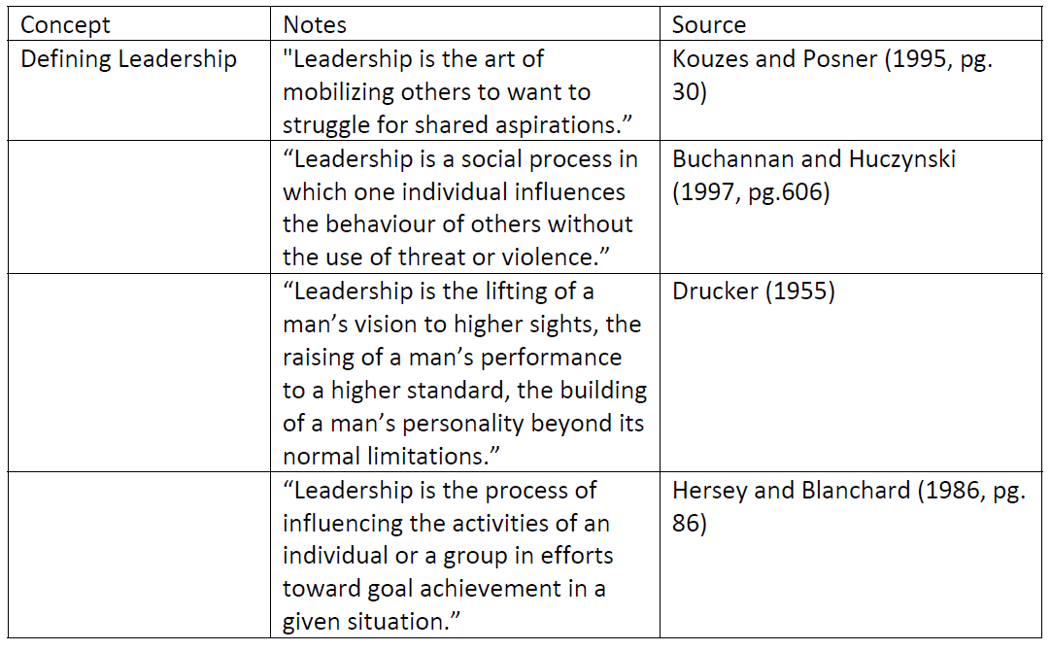
Deconstruct- Finding, Reading and Categorizing
When you find the literature, start to extract or highlight the points that you want to use in your review.
Organize the articles into folders for each theme or by keywords
You can use a table to help you summarize the key points you want to use.

Slide 14
Reconstructing the Literature-
Before you start to write establish a story line that will link all the points you extracted together
It would helpful to jot down the basic storyline, so you can then follow.
Building an Argument/Debate:
A concept/point is introduced
Add supporting references and previous research results that AGREE+
Add (If there is) information refuting/contradicting the point made, +
Add a conclusion- summarize the key point from the debate.
See Examples at the end of Handout, also provided in class.

Slide 15
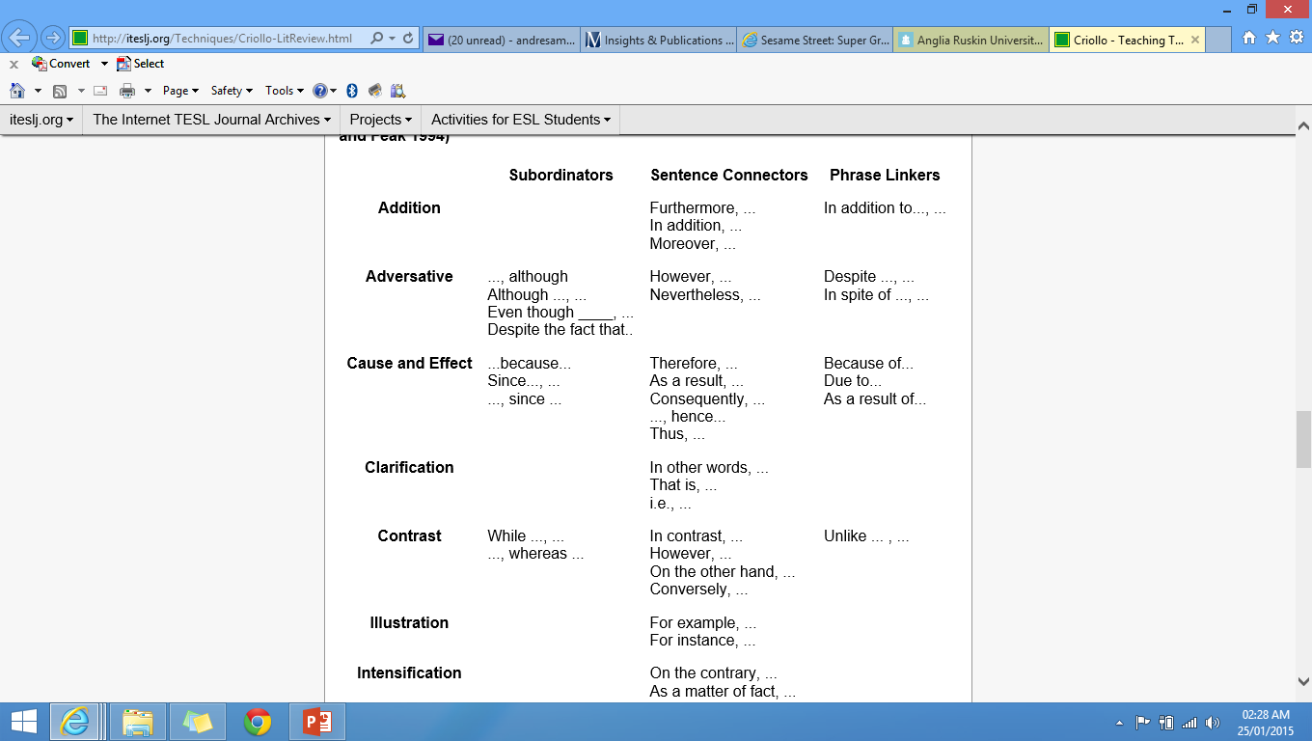
Connecting Phrases and words to create the argument

Slide 16
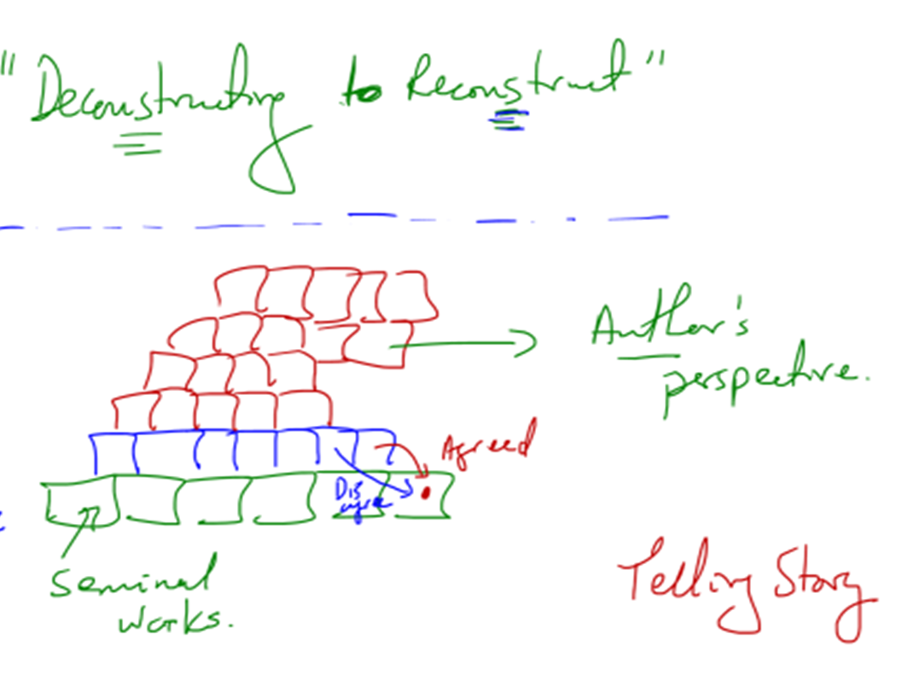

Slide 17
Structuring the Review
Logically organized:
by theme or subtopic,
From broad to narrow
2.0 Introduction-
Should describes the content, scope, and organization of the review
the strategy used in the Literature search
Outline the bodies of literature that will be covered in the subsequent sections

Slide 18
Make sure you are keeping the review relevant to the RQ and objectives
Within each section use a combination of:
Theory
Models/Frameworks
Prior Studies- what have they found
2.1 Theme 1
2.2 Theme 2
2.3 Theme 3
Etc
2.4 Summary of Literature Review
Note:
Themes will represent the keywords extracted from the RQ and objectives.
Use these keywords as the headings and subheadings in the chapter

